Slide 1

Chapter 6
Data Encryption Standard (DES)
6.<number>
Copyright © The McGraw-Hill Companies, Inc. Permission required for reproduction or display.

Slide 2
Modern Block Ciphers
now look at modern block ciphers
one of the most widely used types of cryptographic algorithms
provide secrecy /authentication services
focus on DES (Data Encryption Standard)
to illustrate block cipher design principles
Notes:
Modern block ciphers are widely used to provide encryption of quantities of information, and/or a cryptographic checksum to ensure the contents have not been altered. We continue to use block ciphers because they are comparatively fast, and because we know a fair amount about how to design them. Will use the widely known DES algorithm to illustrate some key block cipher design principles.

Slide 3
Block vs Stream Ciphers
block ciphers process messages in blocks, each of which is then en/decrypted
like a substitution on very big characters
  64-bits or more
stream ciphers process messages a bit or byte at a time when en/decrypting
many current ciphers are block ciphers
broader range of applications
Notes:
Block ciphers work a on block / word at a time, which is some number of bits. All of these bits have to be available before the block can be processed. Stream ciphers work on a bit or byte of the message at a time, hence process it as a “stream”. Block ciphers are currently better analysed, and seem to have a broader range of applications, hence focus on them.

Slide 4
Feistel Cipher Structure
Horst Feistel devised the feistel cipher
  based on concept of invertible product cipher
partitions input block into two halves
  process through multiple rounds which
  perform a substitution on left data half
  based on round function of right half & subkey
  then have permutation swapping halves
implements Shannon’s S-P net concept
Notes:
Horst Feistel, working at IBM Thomas J Watson Research Labs devised a suitable invertible cipher structure in early 70's.
One of Feistel's main contributions was the invention of a suitable structure which adapted Shannon's S-P network in an easily inverted structure. It partitions input block into two halves which are processed through multiple rounds which perform a substitution on left data half, based on round function of right half & subkey, and then have permutation swapping halves. Essentially the same h/w or s/w is used for both encryption and decryption, with just a slight change in how the keys are used. One layer of S-boxes and the following P-box are used to form the round function.

Slide 5
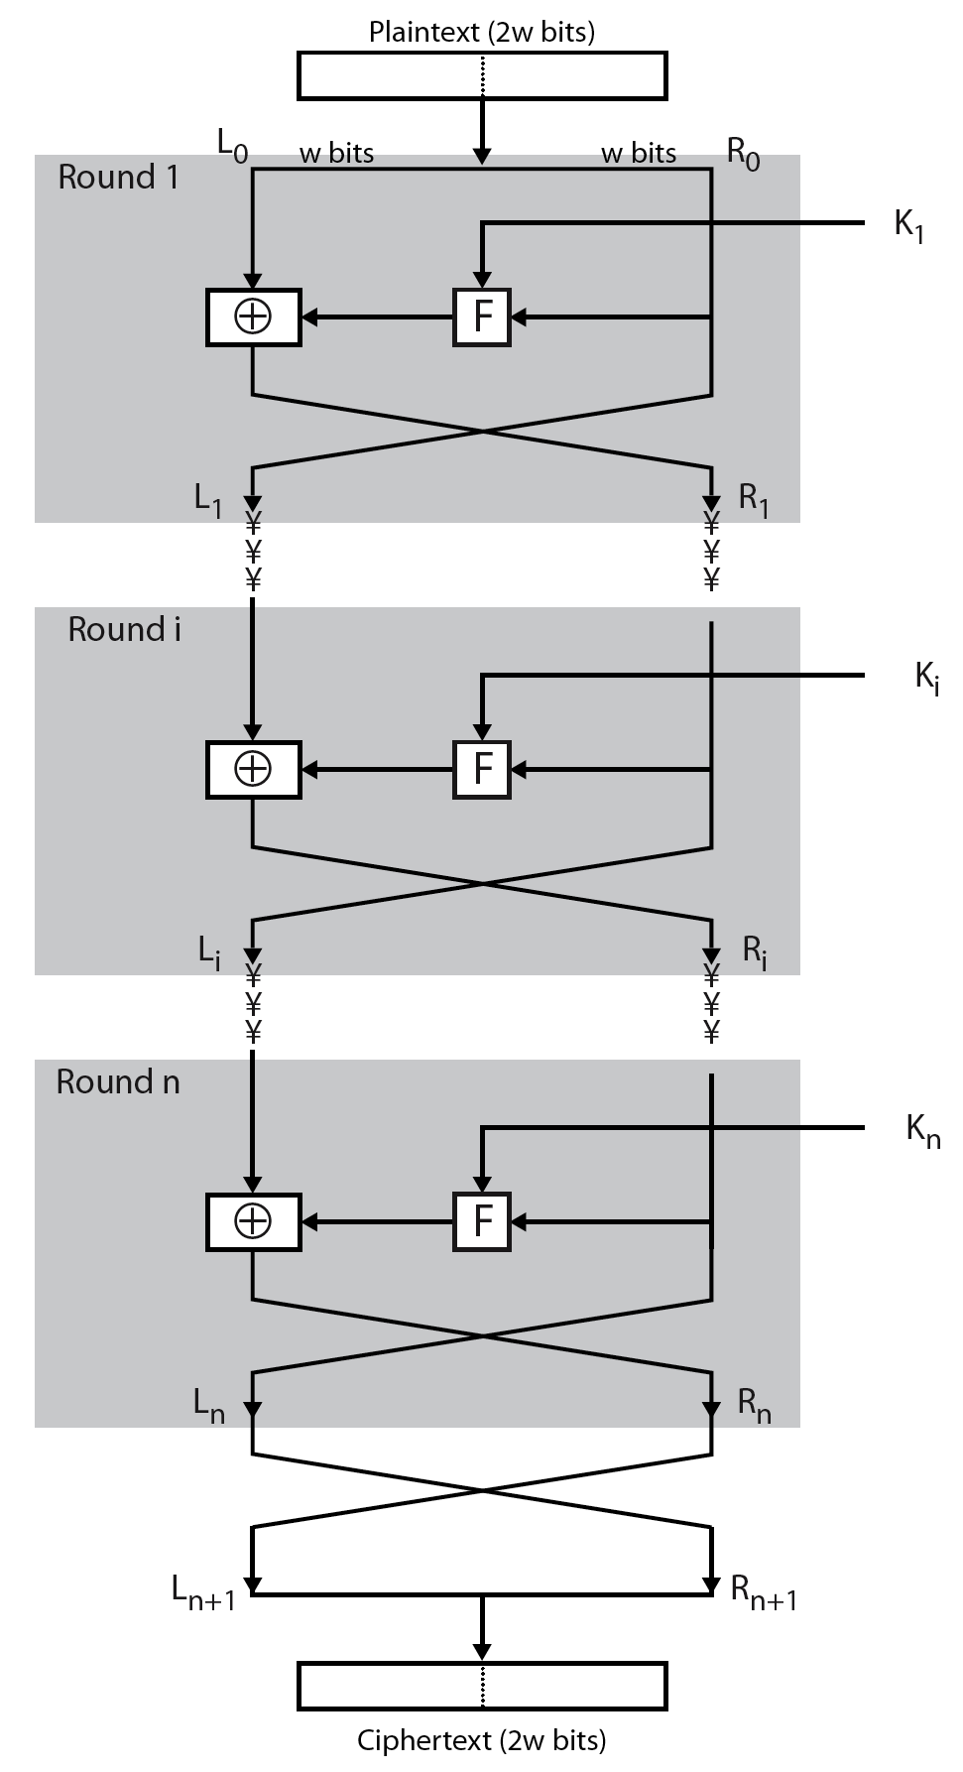
Feistel Cipher Structure
Notes:
Stallings Figure 3.2 illustrates the classical feistel cipher structure, with data split in 2 halves, processed through a number of rounds which perform a substitution on left half using output of round function on right half & key, and a permutation which swaps halves, as listed previously.

Slide 6
Feistel Cipher Design Elements
block size
key size
number of rounds
subkey generation algorithm
round function
fast software en/decryption
ease of analysis
Notes:
The exact realization of a Feistel network depends on the choice of the following parameters and design features:
block size - increasing size improves security, but slows cipher
key size - increasing size improves security, makes exhaustive key searching harder, but may slow cipher
number of rounds - increasing number improves security, but slows cipher
subkey generation algorithm - greater complexity can make analysis harder, but slows cipher
round function - greater complexity can make analysis harder, but slows cipher
fast software en/decryption - more recent concern for practical use
ease of analysis - for easier validation & testing of strength

Slide 7
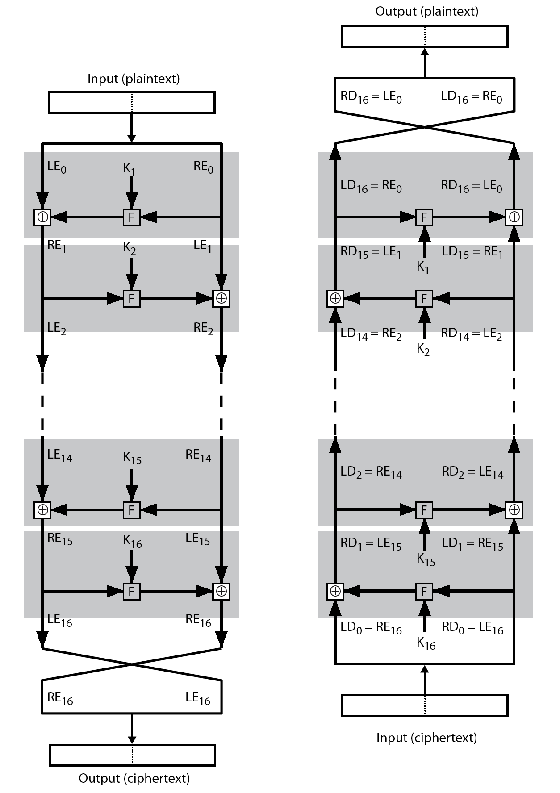
Feistel Cipher Decryption
Notes:
The process of decryption with a Feistel cipher, as shown in Stallings Figure 3.3, is essentially the same as the encryption process. The rule is as follows: Use the ciphertext as input to the algorithm, but use the subkeys Ki in reverse order. That is, use Kn in the first round, Kn–1 in the second round, and so on until K1 is used in the last round. This is a nice feature because it means we need not implement two different algorithms, one for encryption and one for decryption.

Slide 8
Diffusion and Confusion
The terms diffusion and confusion were introduced by Claude Shannon to capture the two basic building blocks for any cryptographic system. Every block cipher involves a transformation of a block of plaintext into a block of ciphertext, where the transformation depends on the key.
The mechanism of diffusion seeks to make the statistical relationship between the plaintext and ciphertext as complex as possible in order to thwart attempts to deduce the key.
Confusion seeks to make the relationship between the statistics of the ciphertext and the value of the encryption key as complex as possible, again to thwart attempts to discover the key.
So successful are diffusion and confusion in capturing the essence of the desired attributes of a block cipher that they have become the cornerstone of modern block cipher design.
6.<number>

Slide 9
Block Cipher Principles
most symmetric block ciphers are based on a Feistel Cipher Structure
needed since must be able to decrypt ciphertext to recover messages efficiently
block ciphers look like an extremely large substitution
would need table of 2⁶⁴ entries for a 64-bit block
instead create from smaller building blocks
using idea of a product cipher
Notes:
Most symmetric block encryption algorithms in current use are based on a structure referred to as a Feistel block cipher. A block cipher operates on a plaintext block of n bits to produce a ciphertext block of n bits. An arbitrary reversible substitution cipher for a large block size is not practical, however, from an implementation and performance point of view. In general, for an n-bit general substitution block cipher, the size of the key is n x 2^{n}. For a 64-bit block, which is a desirable length to thwart statistical attacks, the key size is 64 x 2⁶⁴ = 2⁷⁰ = 10²¹ bits. In considering these difficulties, Feistel points out that what is needed is an approximation to the ideal block cipher system for large n, built up out of components that are easily realizable.

Slide 10
Data Encryption Standard (DES)
The Data Encryption Standard (DES) is a symmetric-key block cipher published by the National Institute of Standards and Technology (NIST).
In 1973, NIST published a request for proposals for a national symmetric-key cryptosystem. A proposal from IBM, a modification of a project called Lucifer, was accepted as DES. DES was published in the Federal Register in March 1975 as a draft of the Federal Information Processing Standard (FIPS).
6.<number>

Slide 11

6.1.2 Overview
DES is a block cipher, as shown in Figure 6.1.
Figure 6.1 Encryption and decryption with DES
6.<number>

Slide 12
6-2 DES STRUCTURE
The encryption process is made of two permutations (P-boxes), which we call initial and final permutations, and sixteen Feistel rounds.
Topics discussed in this section:
6.2.1 Initial and Final Permutations
6.2.2 Rounds
6.2.3 Cipher and Reverse Cipher
6.2.4 Examples
6.<number>

Slide 13
DES Design Controversy
although DES standard is public
was considerable controversy over design
  in choice of 56-bit key (vs Lucifer 128-bit)
  and because design criteria were classified
subsequent events and public analysis show in fact design was appropriate
use of DES has flourished
  especially in financial applications
  still standardised for legacy application use
Notes:
Before its adoption as a standard, the proposed DES was subjected to intense & continuing criticism over the size of its key & the classified design criteria.
Recent analysis has shown despite this controversy, that DES is well designed. DES is theoretically broken using Differential or Linear Cryptanalysis but in practise is unlikely to be a problem yet. Also rapid advances in computing speed though have rendered the 56 bit key susceptible to exhaustive key search, as predicted by Diffie & Hellman.
DES has flourished and is widely used, especially in financial applications. It is still standardized for legacy systems, with either AES or triple DES for new applications.

Slide 14

6-2 Continue
Figure 6.2 General structure of DES
6.<number>

Slide 15
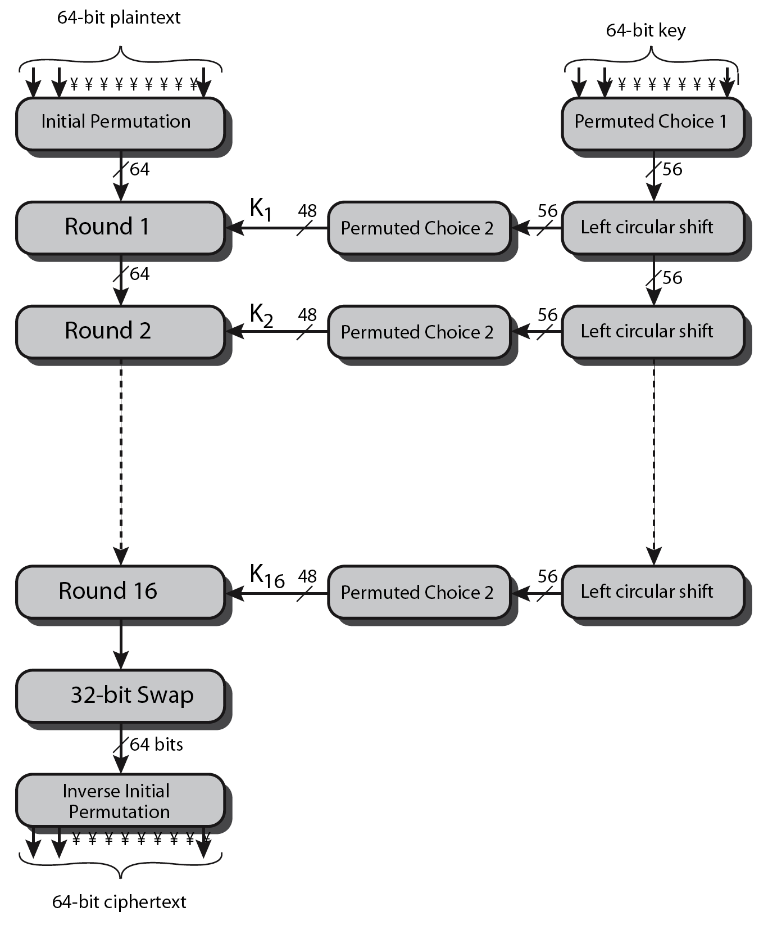
DES Encryption Overview
Notes:
The overall scheme for DES encryption is illustrated in Stallings Figure3.4, which takes as input 64-bits of data and of key.
The left side shows the basic process for enciphering a 64-bit data block which consists of:
- an initial permutation (IP) which shuffles the 64-bit input block
- 16 rounds of a complex key dependent round function involving substitutions & permutations
- a final permutation, being the inverse of IP
The right side shows the handling of the 56-bit key and consists of:
- an initial permutation of the key (PC1) which selects 56-bits out of the 64-bits input, in two 28-bit halves
- 16 stages to generate the 48-bit subkeys using a left circular shift and a permutation of the two 28-bit halves

Slide 16

6.2.1 Initial and Final Permutations
Figure 6.3 Initial and final permutation steps in DES
6.<number>

Slide 17
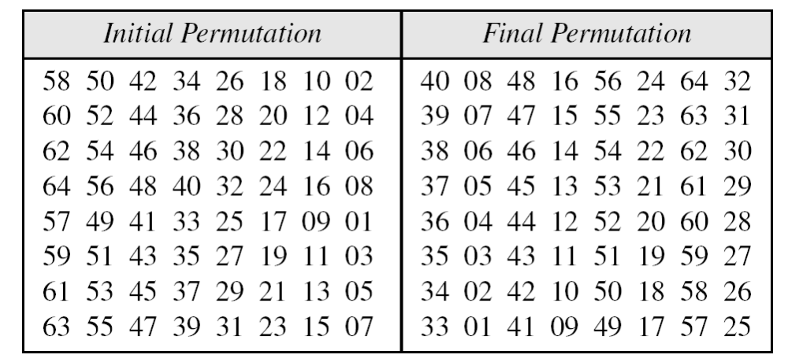
6.2.1 Continue
Table 6.1 Initial and final permutation tables
6.<number>

Slide 18

6.2.1 Continued
Note
The initial and final permutations are straight P-boxes that are inverses
of each other.
They have no cryptography significance in DES.
6.<number>

Slide 19

6.2.2 Rounds
DES uses 16 rounds. Each round of DES is a Feistel cipher.
Figure 6.4
A round in DES
(encryption site)
6.<number>

Slide 20
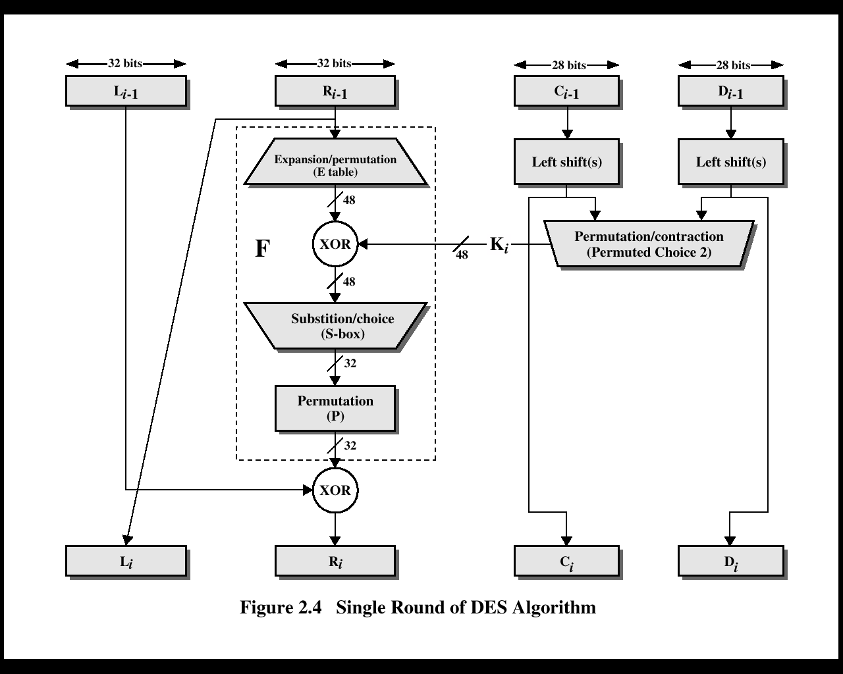
Henric Johnson

Slide 21

DES Round Structure
Notes:
Stallings Figure 3.6 illustrates the internal structure of the DES round function F. The R input is first expanded to 48 bits by using expansion table E that defines a permutation plus an expansion that involves duplication of 16 of the R bits (Stallings Table 3.2c). The resulting 48 bits are XORed with Ki. This 48-bit result passes through a substitution function comprising 8 S-boxes which each map 6 input bits to 4 output bits, producing a 32-bit output, which is then permuted by permutation P as defined by Stallings Table 3.2d.

Slide 22

6.2.2 Continued
DES Function
The heart of DES is the DES function. The DES function applies a 48-bit key to the rightmost 32 bits to produce a 32-bit output.
Figure 6.5
DES function
6.<number>

Slide 23

6.2.2 Continue
Expansion P-box
Since R_{I−1} is a 32-bit input and K_{I} is a 48-bit key, we first need to expand R_{I−1} to 48 bits.
Figure 6.6 Expansion permutation
6.<number>

Slide 24

6.2.2 Continue
S-Boxes
The S-boxes do the real mixing (confusion). DES uses 8 S-boxes, each with a 6-bit input and a 4-bit output. See Figure 6.7.
Figure 6.7 S-boxes
6.<number>

Slide 25

6.2.2 Continue
Figure 6.8 S-box rule
6.<number>

Slide 26
6.2.3 Cipher and Reverse Cipher
Using mixers and swappers, we can create the cipher and reverse cipher, each having 16 rounds.
First Approach
To achieve this goal, one approach is to make the last round (round 16) different from the others; it has only a mixer and no swapper.
Note
In the first approach, there is no swapper in the last round.
6.<number>

Slide 27

6.2.3 Continued
Figure 6.9 DES cipher and reverse cipher for the first approach
6.<number>

Slide 28
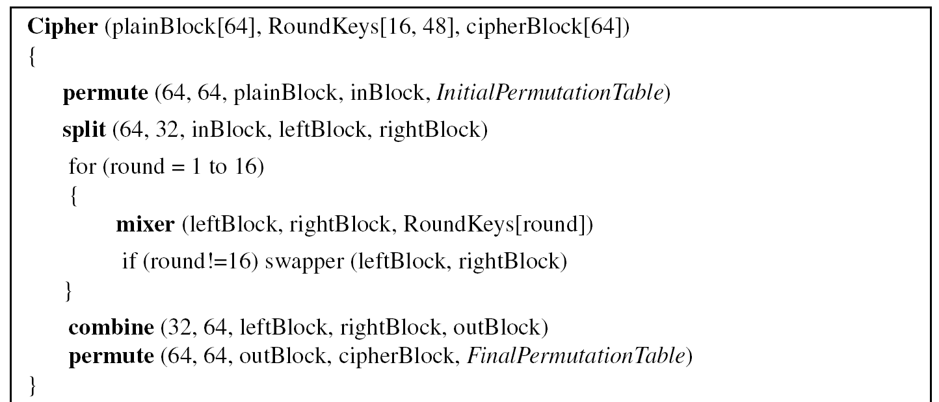
6.2.3 Continued
Algorithm 6.1 Pseudocode for DES cipher
6.<number>

Slide 29
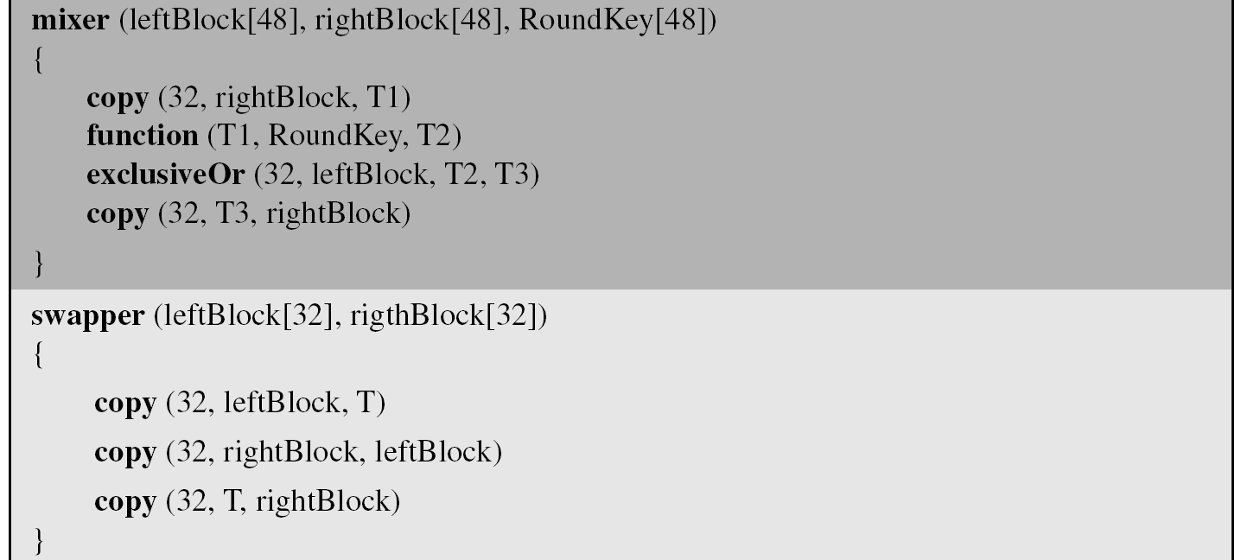
6.2.3 Continued
Algorithm 6.1 Pseudocode for DES cipher (Continued)
6.<number>

Slide 30
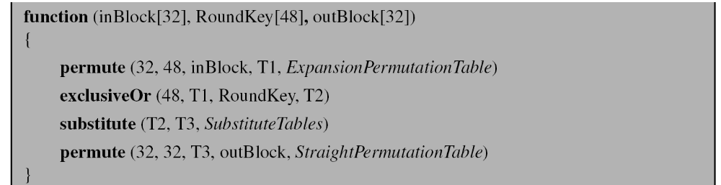
6.2.3 Continued
Algorithm 6.1 Pseudocode for DES cipher (Continued)
6.<number>

Slide 31
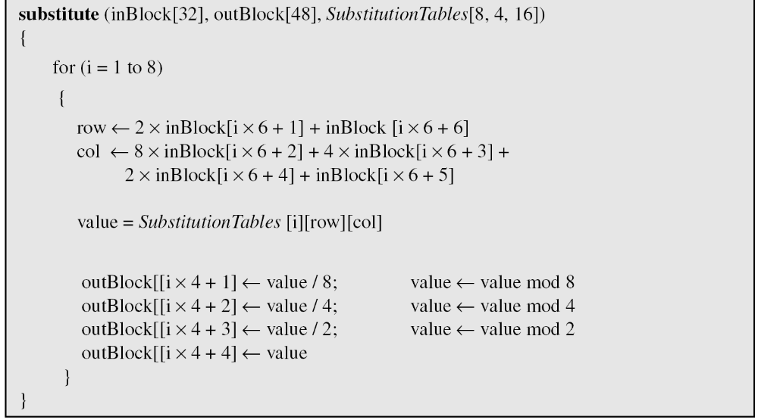
6.2.3 Continued
Algorithm 6.1 Pseudocode for DES cipher (Continued)
6.<number>

Slide 32
6.2.3 Continued
Alternative Approach
We can make all 16 rounds the same by including one swapper to the 16th round and add an extra swapper after that (two swappers cancel the effect of each other).
Key Generation
The round-key generator creates sixteen 48-bit keys out of a 56-bit cipher key.
6.<number>

Slide 33

6.2.3 Continued
Figure 6.10
Key generation
6.<number>

Slide 34
6-4 Multiple DES
The major criticism of DES regards its key length. Fortunately DES is not a group. This means that we can use double or triple DES to increase the key size.
Topics discussed in this section:
6.4.1 Double DES
6.4.4 Triple DES
6.<number>

Slide 35
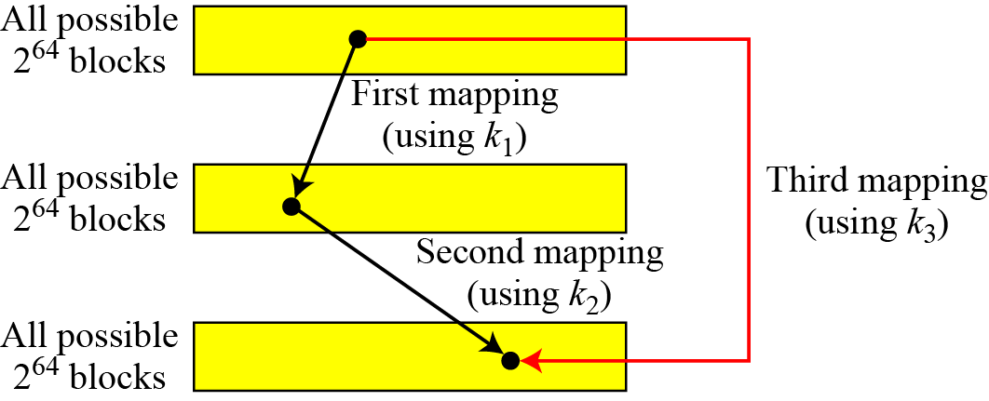
6-4 Continued
A substitution that maps every possible input to every possible output is a group.
Figure 6.13 Composition of mapping
6.<number>

Slide 36
6.4.1 Double DES
The first approach is to use double DES (2DES).
Meet-in-the-Middle Attack
However, using a known-plaintext attack called meet-in-the-middle attack proves that double DES improves this vulnerability slightly (to 2⁵⁷ tests), but not tremendously (to 2¹¹²).
6.<number>

Slide 37
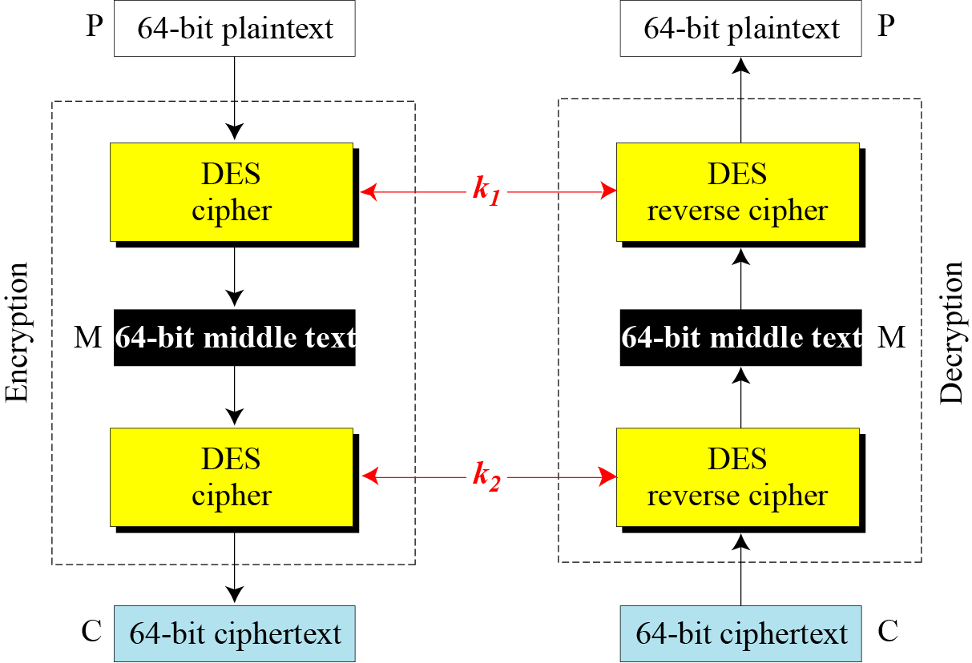
6.4.1 Continued
Figure 6.14 Meet-in-the-middle attack for double DES
6.<number>

Slide 38
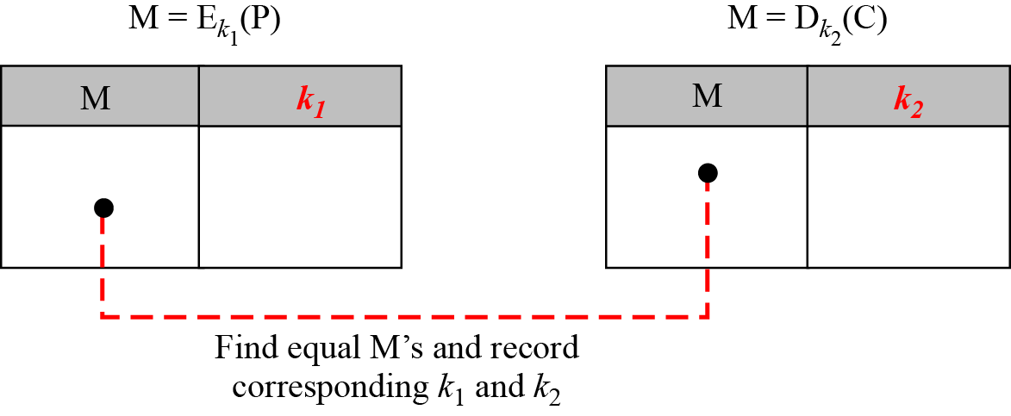
6.4.1 Continued
Figure 6.15 Tables for meet-in-the-middle attack
6.<number>

Slide 39
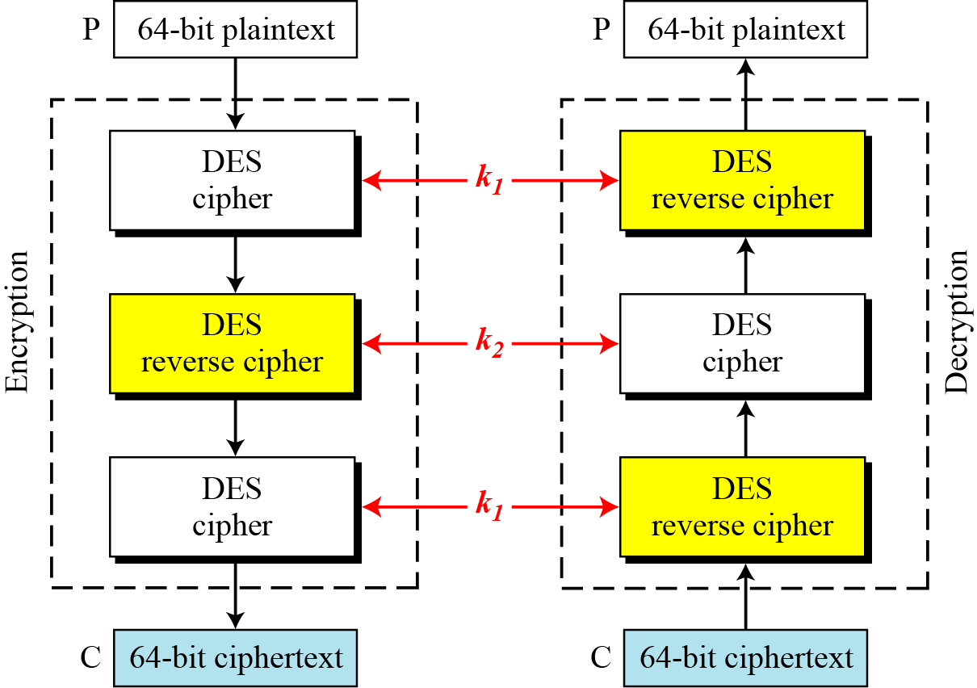
6.4.2 Triple DES
Figure 6.16 Triple DES with two keys
6.<number>

Slide 40
6.4.2 Continuous
Triple DES with Three Keys
The possibility of known-plaintext attacks on triple DES with two keys has enticed some applications to use triple DES with three keys. Triple DES with three keys is used by many applications such as PGP (See Chapter 16).
6.<number>

Slide 41
6-5 Security of DES
DES, as the first important block cipher, has gone through much scrutiny. Among the attempted attacks, three are of interest: brute-force, differential cryptanalysis, and linear cryptanalysis.
Topics discussed in this section:
6.5.1 Brute-Force Attack
6.5.2 Differential Cryptanalysis
6.5.3 Linear Cryptanalysis
6.<number>

Slide 42
6.5.1 Brute-Force Attack
We have discussed the weakness of short cipher key in DES. Combining this weakness with the key complement weakness, it is clear that DES can be broken using 2⁵⁵ encryptions.
6.<number>

Slide 43
6.5.2 Differential Cryptanalysis
It has been revealed that the designers of DES already knew about this type of attack and designed S-boxes and chose 16 as the number of rounds to make DES specifically resistant to this type of attack.
Note
We show an example of DES differential cryptanalysis in Appendix N.
6.<number>

Slide 44
6.5.3 Linear Cryptanalysis
Linear cryptanalysis is newer than differential cryptanalysis. DES is more vulnerable to linear cryptanalysis than to differential cryptanalysis. S-boxes are not very resistant to linear cryptanalysis. It has been shown that DES can be broken using 2⁴³ pairs of known plaintexts. However, from the practical point of view, finding so many pairs is very unlikely.
Note
We show an example of DES linear cryptanalysis in Appendix N.
6.<number>

Slide 45
Advanced Encryption Standard
(AES)
7.<number>
Copyright © The McGraw-Hill Companies, Inc. Permission required for reproduction or display.

Slide 46
7-1 INTRODUCTION
The Advanced Encryption Standard (AES) is a symmetric-key block cipher published by the National Institute of Standards and Technology (NIST) in December 2001.
7.<number>

Slide 47
7.1.1 History.
In February 2001, NIST announced that a draft of the Federal Information Processing Standard (FIPS) was available for public review and comment. Finally, AES was published as FIPS 197 in the Federal Register in December 2001.
7.<number>

Slide 48
7.1.2 Criteria
The criteria defined by NIST for selecting AES fall into three areas:
1. Security
2. Cost
3. Implementation.
7.<number>

Slide 49
Origins
clear a replacement for DES was needed
  have theoretical attacks that can break it
  have demonstrated exhaustive key search attacks
can use Triple-DES – but slow, has small blocks
US NIST issued call for ciphers in 1997
15 candidates accepted in Jun 98
5 were shortlisted in Aug-99
Rijndael was selected as the AES in Oct-2000
issued as FIPS PUB 197 standard in Nov-2001
Notes:
The Advanced Encryption Standard (AES) was published by NIST (National Institute of Standards and Technology) in 2001. AES is a symmetric block cipher that is intended to replace DES as the approved standard for a wide range of applications. The AES cipher (& other candidates) form the latest generation of block ciphers, and now we see a significant increase in the block size - from the old standard of 64-bits up to 128-bits; and keys from 128 to 256-bits. In part this has been driven by the public demonstrations of exhaustive key searches of DES. Whilst triple-DES is regarded as secure and well understood, it is slow, especially in s/w. In a first round of evaluation, 15 proposed algorithms were accepted. A second round narrowed the field to 5 algorithms. NIST completed its evaluation process and published a final standard (FIPS PUB 197) in November of 2001. NIST selected Rijndael as the proposed AES algorithm. The two researchers who developed and submitted Rijndael for the AES are both cryptographers from Belgium: Dr. Joan Daemen and Dr.Vincent Rijmen.

Slide 50
AES Requirements
private key symmetric block cipher
128-bit data, 128/192/256-bit keys
stronger & faster than Triple-DES
active life of 20-30 years (+ archival use)
provide full specification & design details
both C & Java implementations
NIST have released all submissions & unclassified analyses
Notes:
Listed above are NIST’s requirements for the AES candidate submissions. These criteria span the range of concerns for the practical application of modern symmetric block ciphers.

Slide 51
AES Evaluation Criteria
initial criteria:
  security – effort for practical cryptanalysis
  cost – in terms of computational efficiency
  algorithm & implementation characteristics
final criteria
  general security
  ease of software & hardware implementation
  implementation attacks
  flexibility (in en/decrypt, keying, other factors)
Notes:
In fact, two set of criteria evolved. When NIST issued its original request for candidate algorithm nominations in 1997, the request stated that candidate algorithms would be compared based on the factors shown in Stallings Table5.1, which were used to evaluate field of 15 candidates to select shortlist of 5. These had categories of security, cost, and algorithm & implementation characteristics.
The final criteria evolved during the evaluation process, and were used to select Rijndael from that short-list, and more details are given in Stallings Table 5.2, with categories of: general security, ease of software & hardware implementation, implementation attacks, & flexibility (in en/decrypt, keying, other factors).

Slide 52
AES Shortlist
after testing and evaluation, shortlist in Aug-99:
  MARS (IBM) - complex, fast, high security margin
  RC6 (USA) - v. simple, v. fast, low security margin
  Rijndael (Belgium) - clean, fast, good security margin
  Serpent (Euro) - slow, clean, v. high security margin
  Twofish (USA) - complex, v. fast, high security margin
then subject to further analysis & comment
saw contrast between algorithms with
  few complex rounds verses many simple rounds
  which refined existing ciphers verses new proposals
Notes:
The AES shortlist of 5 ciphers was as shown. Note mix of commercial (MARS, RC6, Twofish) verses academic (Rijndael, Serpent) proposals, sourced from various countries.
All were thought to be good – it came down to the best balance of attributes to meet criteria, in particular the balance between speed, security & flexibility.

Slide 53
The AES Cipher - Rijndael
designed by Rijmen-Daemen in Belgium
has 128/192/256 bit keys, 128 bit data
an iterative rather than feistel cipher
  processes data as block of 4 columns of 4 bytes
  operates on entire data block in every round
  Instead each full round consists of four separate functions: byte substitution, permutation, arithmetic operations over a finite field and XOR with a key
designed to be:
  resistant against known attacks
  speed and code compactness on many CPUs
  design simplicity
Notes:
The Rijndael proposal for AES defined a cipher in which the block length and the key length can be independently specified to be 128,192,or 256 bits. The AES specification uses the same three key size alternatives but limits the block length to 128 bits. Rijndael is an academic submission, based on the earlier Square cipher, from Belgium academics Dr Joan Daemen and Dr Vincent Rijmen. It is an iterative cipher (operates on entire data block in every round) rather than feistel (operate on halves at a time), and was designed to have characteristics of: Resistance against all known attacks, Speed and code compactness on a wide range of platforms, & Design simplicity.

Slide 54
Rijndael
data block of 4 columns of 4 bytes is state
key is expanded to array of words
has 9/11/13 rounds in which state undergoes:
  byte substitution (1 S-box used on every byte)
  shift rows (permute bytes between groups/columns)
  mix columns (subs using matrix multipy of groups)
  add round key (XOR state with key material)
  view as alternating XOR key & scramble data bytes
initial XOR key material & incomplete last round
with fast XOR & table lookup implementation
Notes:
The input to the AES encryption and decryption algorithms is a single 128-bit block, depicted in FIPS PUB 197, as a square matrix of bytes .This block is copied into the State array, which is modified at each stage of encryption or decryption. After the final stage, State is copied to an output.
The key is expanded into 44/52/60 lots of 32-bit words (see later), with 4 used in each round.
The data computation then consists of an “add round key” step, then 9/11/13 rounds with all 4 steps, and a final 10th/12th/14th step of byte subs + mix cols + add round key. This can be viewed as alternating XOR key & scramble data bytes operations. All of the steps are easily reversed, and can be efficiently implemented using XOR’s & table lookups.

Slide 55

Rijndael
Notes:
Stallings Figure 5.1 shows the overall structure of AES, as detailed on the previous slide.

Slide 56
Byte Substitution
a simple substitution of each byte
uses one table of 16x16 bytes containing a permutation of all 256 8-bit values
each byte of state is replaced by byte indexed by row (left 4-bits) & column (right 4-bits)
  eg. byte {95} is replaced by byte in row 9 column 5
  which has value {2A}
S-box constructed using defined transformation of values in GF(2⁸)
designed to be resistant to all known attacks
Notes:
Now discuss each of the four stages used in AES. The Substitute bytes stage uses an S-box to perform a byte-by-byte substitution of the block. There is a single 8-bit wide S-box used on every byte. This S-box is a permutation of all 256 8-bit values, constructed using a transformation which treats the values as polynomials in GF(2⁸) – however it is fixed, so really only need to know the table when implementing. Decryption requires the inverse of the table. These tables are given in Stallings Table 4.5.
The table was designed to be resistant to known cryptanalytic attacks. Specifically, the Rijndael developers sought a design that has a low correlation between input bits and output bits, with the property that the output cannot be described as a simple mathematical function of the input, with no fixed points and no “opposite fixed points”.

Slide 57

Byte Substitution
Notes:
As this diagram from Stallings Fig 5.4a shows, the Byte Substitution operates on each byte of state independently, with the input byte used to index a row/col in the table to retrieve the substituted value.

Slide 58
Shift Rows
a circular byte shift in each each
  1st row is unchanged
  2nd row does 1 byte circular shift to left
  3rd row does 2 byte circular shift to left
  4th row does 3 byte circular shift to left
decrypt inverts using shifts to right
since state is processed by columns, this step permutes bytes between the columns
Notes:
The ShiftRows stage provides a simple “permutation” of the data, whereas the other steps involve substitutions. Further, since the state is treated as a block of columns, it is this step which provides for diffusion of values between columns. It performs a circular rotate on each row of 0, 1, 2 & 3 places for respective rows. When decrypting it performs the circular shifts in the opposite direction for each row. This row shift moves an individual byte from one column to another, which is a linear distance of a multiple of 4 bytes, and ensures that the 4 bytes of one column are spread out to four different columns.

Slide 59

Shift Rows
Notes:
Stalling Figure 5.5a illustrates the Shift Rows permutation.

Slide 60

Mix Columns
each column is processed separately
each byte is replaced by a value dependent on all 4 bytes in the column
effectively a matrix multiplication in GF(2⁸) using prime poly m(x) =x⁸+x⁴+x³+x+1
Notes:
The MixColumns stage is a substitution that makes use of arithmetic over GF(2^8). Each byte of a column is mapped into a new value that is a function of all four bytes in that column. It is designed as a matrix multiplication where each byte is treated as a polynomial in GF(2⁸). The inverse used for decryption involves a different set of constants.
The constants used are based on a linear code with maximal distance between code words – this gives good mixing of the bytes within each column. Combined with the “shift rows” step provides good avalanche, so that within a few rounds, all output bits depend on all input bits.

Slide 61

Mix Columns
Notes:
Stalling Figure 5.5b illustrates the Mix Columns transformation.

Slide 62
Mix Columns
can express each col as 4 equations
  to derive each new byte in col
decryption requires use of inverse matrix
  with larger coefficients, hence a little harder
have an alternate characterisation
  each column a 4-term polynomial
  with coefficients in GF(2⁸)
  and polynomials multiplied modulo (x⁴+1)
Notes:
In practise, you implement Mix Columns by expressing the transformation on each column as 4 equations (Stallings equation 5.4) to compute the new bytes for that column. This computation only involves shifts, XORs & conditional XORs (for the modulo reduction).
The decryption computation requires the use of the inverse of the matrix, which has larger coefficients, and is thus potentially a little harder & slower to implement.
The designers & the AES standard provide an alternate characterisation of Mix Columns, which treats each column of State to be a four-term polynomial with coefficients in GF(2⁸). Each column is multiplied by a fixed polynomial a(x) given in Stallings eqn 5.7. Whilst this is useful for analysis of the stage, the matrix description is all that’s required for implementation.

Slide 63
Add Round Key
XOR state with 128-bits of the round key
again processed by column (though effectively a series of byte operations)
inverse for decryption identical
  since XOR own inverse, with reversed keys
designed to be as simple as possible
  a form of Vernam cipher on expanded key
  requires other stages for complexity / security
Notes:
Lastly is the Add Round Key stage which is a simple bitwise XOR of the current block with a portion of the expanded key. Note this is the only step which makes use of the key and obscures the result, hence MUST be used at start and end of each round, since otherwise could undo effect of other steps. But the other steps provide confusion/diffusion/non-linearity. That us you can look at the cipher as a series of XOR with key then scramble/permute block repeated. This is efficient and highly secure it is believed.

Slide 64

Add Round Key
Notes:
Stallings Figure 5.4b illustrates the Add Round Key stage, which like Byte Substitution, operates on each byte of state independently.

Slide 65

AES Round
Notes:
Can thus now view all the internal details of the AES round, showing how each byte of the state is manipulated, as shown in Stallings Figure 5.3.

Slide 66
AES Key Expansion
takes 128-bit (16-byte) key and expands into array of 44/52/60 32-bit words
start by copying key into first 4 words
then loop creating words that depend on values in previous & 4 places back
  in 3 of 4 cases just XOR these together
  1st word in 4 has rotate + S-box + XOR round constant on previous, before XOR 4th back
Notes:
The AES key expansion algorithm takes as input a 4-word (16-byte) key and produces a linear array of words, providing a 4-word round key for the initial AddRoundKey stage and each of the 10/12/14 rounds of the cipher. It involves copying the key into the first group of 4 words, and then constructing subsequent groups of 4 based on the values of the previous & 4th back words. The first word in each group of 4 gets “special treatment” with rotate + S-box + XOR constant on the previous word before XOR’ing the one from 4 back. In the 256-bit key/14 round version, there’s also an extra step on the middle word.

Slide 67
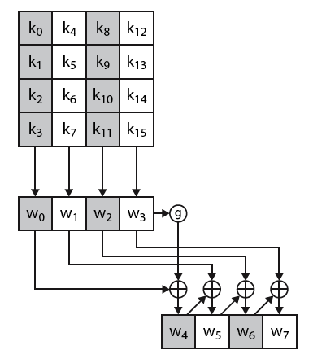
AES Key Expansion
Notes:
The first block of the AES Key Expansion is shown here in Stallings Figure 5.6. It shows each group of 4 bytes in the key being assigned to the first 4 words, then the calculation of the next 4 words based on the values of the previous 4 words, which is repeated enough times to create all the necessary subkey information.

Slide 68
Key Expansion Rationale
designed to resist known attacks
design criteria included
  knowing part key insufficient to find many more
  invertible transformation
  fast on wide range of CPU’s
  use round constants to break symmetry
  diffuse key bits into round keys
  enough non-linearity to hinder analysis
  simplicity of description
Notes:
The Rijndael developers designed the expansion key algorithm to be resistant to known cryptanalytic attacks. It is designed to be simple to implement, but by using round constants break symmetries, and make it much harder to deduce other key bits if just some are known (but once have as many consecutive bits as are in key, can then easily recreate the full expansion). The design criteria used are listed above.

Slide 69
AES Decryption
AES decryption is not identical to encryption since steps done in reverse
but can define an equivalent inverse cipher with steps as for encryption
  but using inverses of each step
  with a different key schedule
works since result is unchanged when
  swap byte substitution & shift rows
  swap mix columns & add (tweaked) round key
Notes:
The AES decryption cipher is not identical to the encryption cipher (Stallings Figure 5.1). The sequence of transformations for decryption differs from that for encryption, although the form of the key schedules for encryption and decryption is the same. This has the disadvantage that two separate software or firmware modules are needed for applications that require both encryption and decryption. There is, however, an equivalent version of the decryption algorithm that has the same structure as the encryption algorithm, with the same sequence of transformations as the encryption algorithm (with transformations replaced by their inverses). To achieve this equivalence,a change in key schedule is needed.
By constructing an equivalent inverse cipher with steps in same order as for encryption, we can derive a more efficient implementation. Clearly swapping the byte substitutions and shift rows has no effect, since work just on bytes. Swapping the mix columns and add round key steps requires the inverse mix columns step be applied to the round keys first – this makes the decryption key schedule a little more complex with this construction, but allows the use of same h/w or s/w for the data en/decrypt computation.

Slide 70
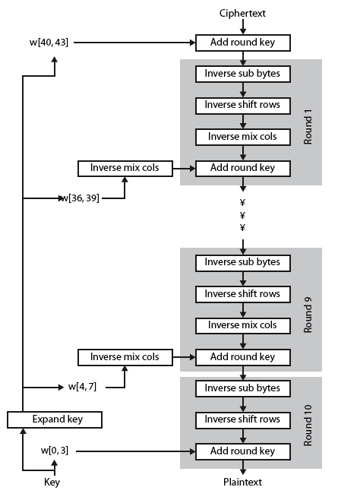
AES Decryption
Notes:
Illustrate the equivalent inverse cipher with Stallings Figure 5.7.

Slide 71
7.1.3 Rounds.
AES is a non-Feistel cipher that encrypts and decrypts a data block of 128 bits. It uses 10, 12, or 14 rounds. The key size, which can be 128, 192, or 256 bits, depends on the number of rounds.
Note
AES has defined three versions, with 10, 12, and 14 rounds.
Each version uses a different cipher key size (128, 192, or 256), but the round keys are always 128 bits.
7.<number>

Slide 72
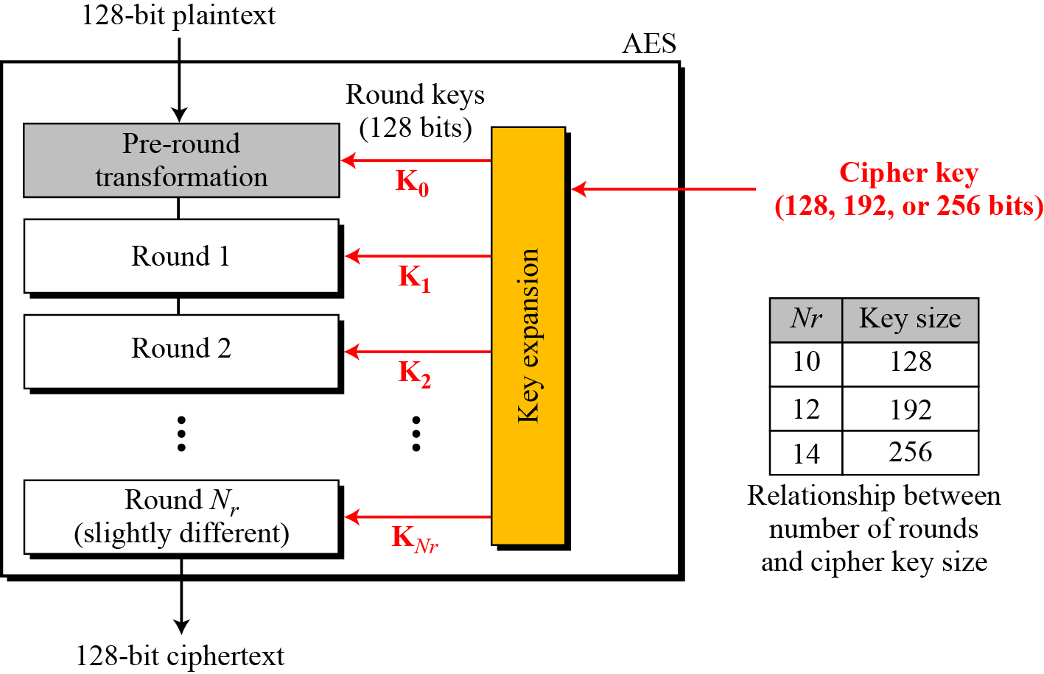
7.1.3 Continue
Figure 7.1 General design of AES encryption cipher
7.<number>

Slide 73
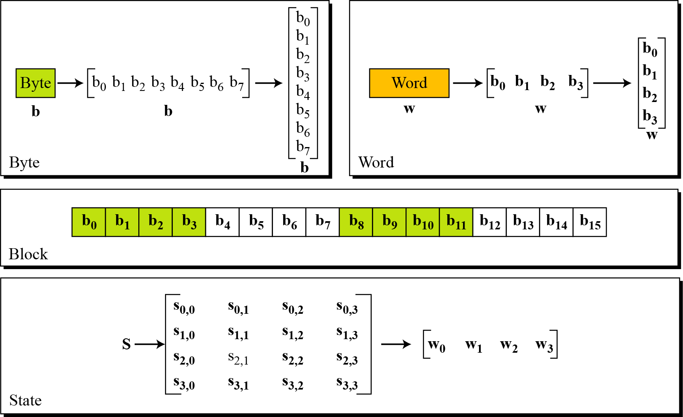
7.1.4 Data Units.
Figure 7.2 Data units used in AES
7.<number>

Slide 74
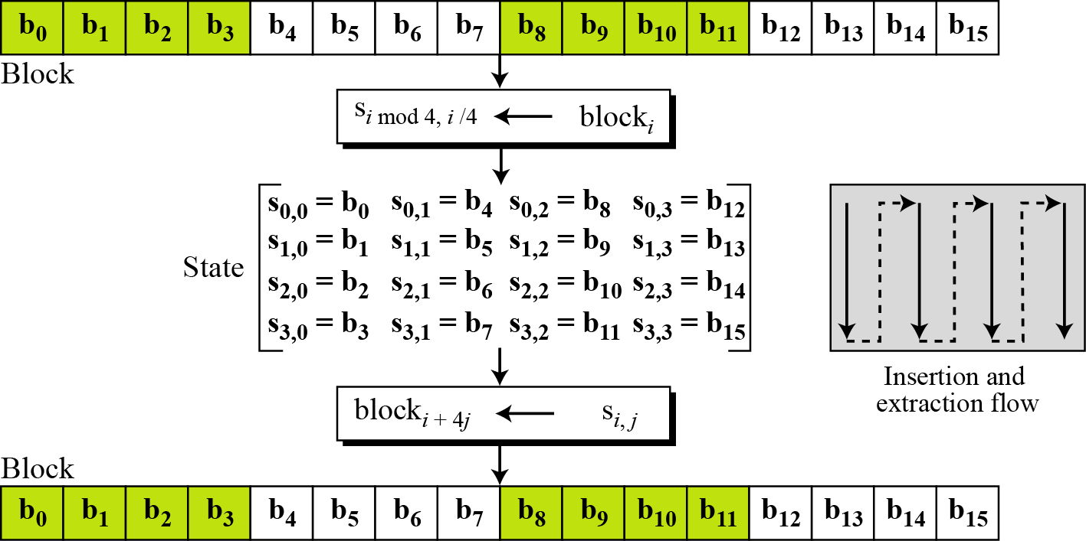
7.1.4 Continue
Figure 7.3 Block-to-state and state-to-block transformation
7.<number>

Slide 75
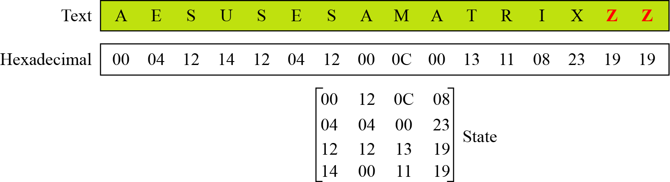
7.1.4 Continue
Example 7.1
Continue
Figure 7.4 Changing plaintext to state
7.<number>

Slide 76
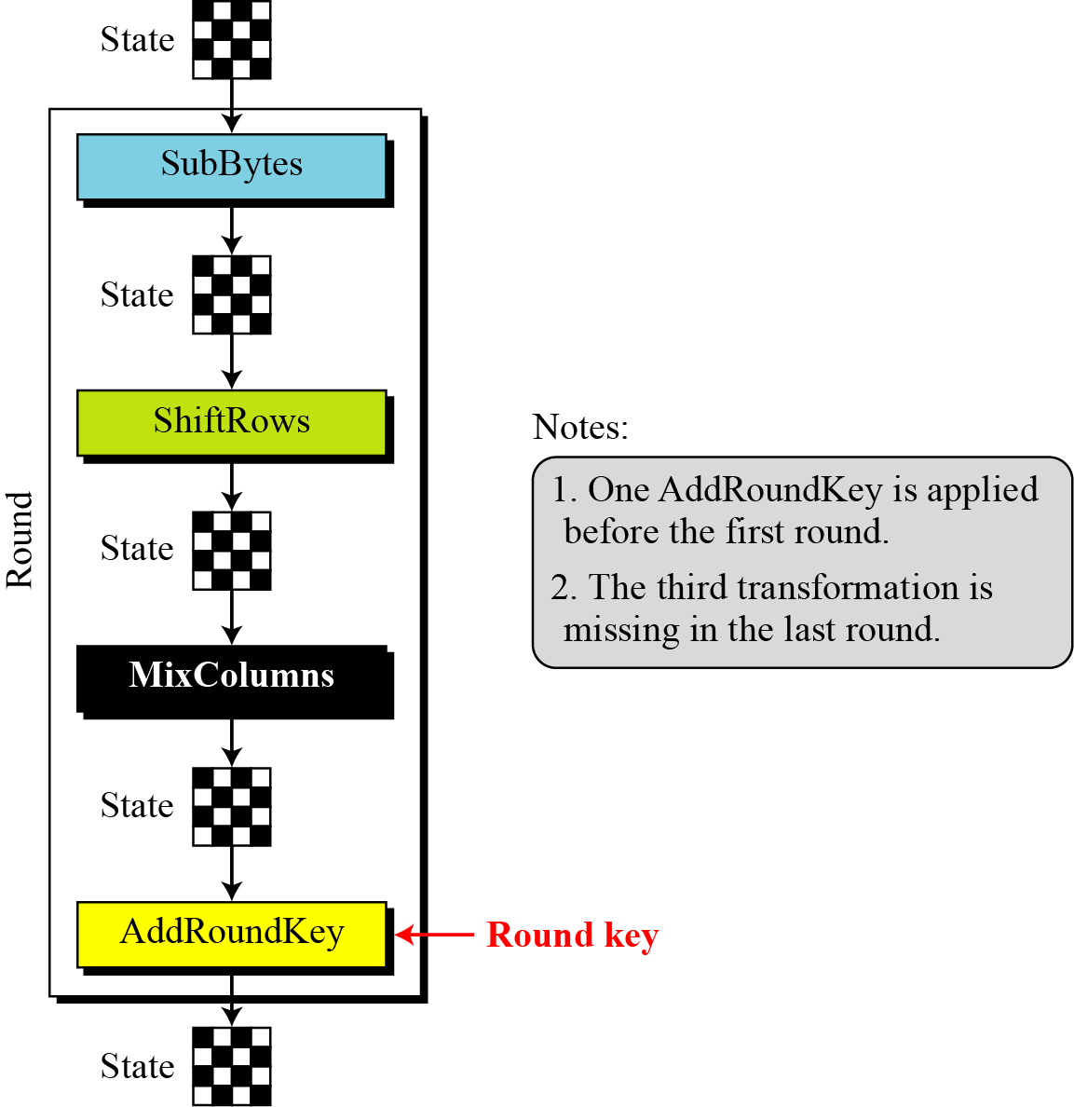
7.1.5 Structure of Each Round
Figure 7.5 Structure of each round at the encryption site
7.<number>

Slide 77
7-2 TRANSFORMATIONS
To provide security, AES uses four types of transformations: substitution, permutation, mixing, and key-adding.
Topics discussed in this section:
7.2.1 Substitution
7.2.2 Permutation
7.2.3 Mixing
7.2.4 Key Adding
7.<number>

Slide 78
7.2.1 Substitution
AES, like DES, uses substitution. AES uses two invertible transformations.
SubBytes
The first transformation, SubBytes, is used at the encryption site. To substitute a byte, we interpret the byte as two hexadecimal digits.
Note
The SubBytes operation involves 16 independent byte-to-byte transformations.
7.<number>

Slide 79
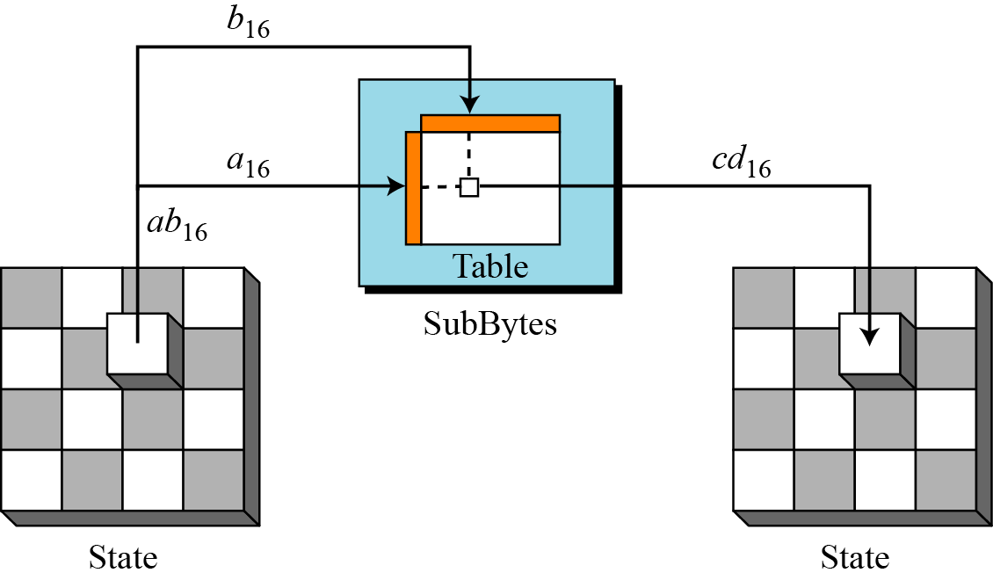
7.2.1 Continue
Figure 7.6 SubBytes transformation
7.<number>

Slide 80
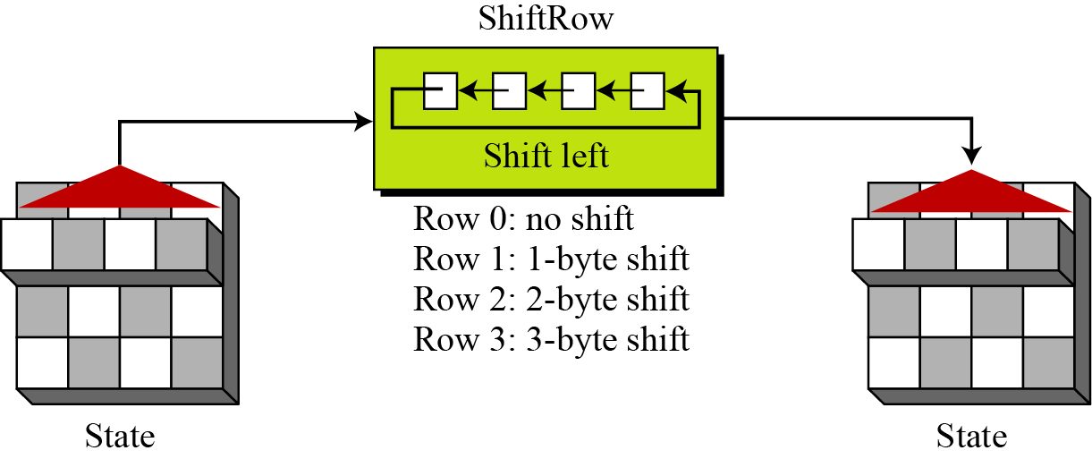
7.2.2 Permutation
Another transformation found in a round is shifting, which permutes the bytes.
ShiftRows
In the encryption, the transformation is called ShiftRows.
Figure 7.9 ShiftRows transformation
7.<number>

Slide 81
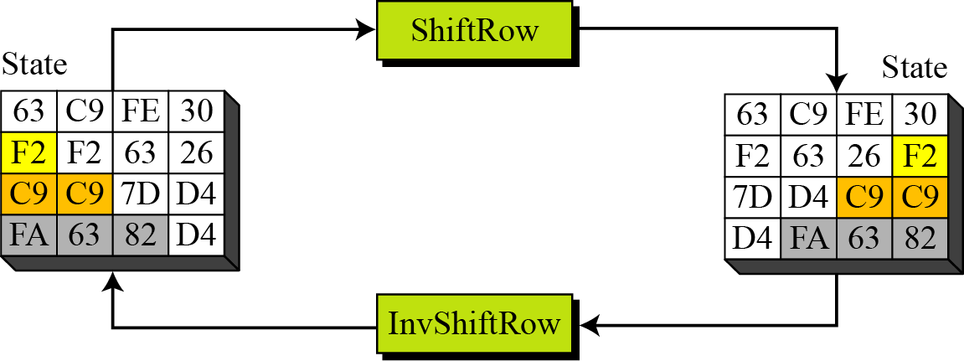
7.2.2 Continue
Example 7.4
Figure 7.10 shows how a state is transformed using ShiftRows transformation. The figure also shows that InvShiftRows transformation creates the original state.
Figure 7.10 ShiftRows transformation in Example 7.4
7.<number>

Slide 82
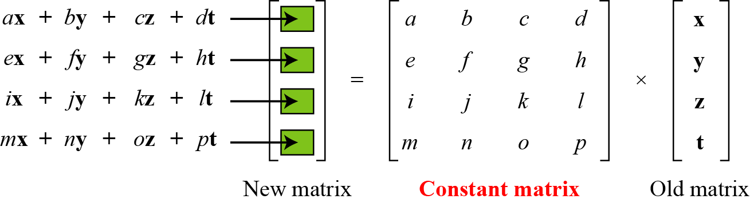
7.2.3 Mixing
We need an interbyte transformation that changes the bits inside a byte, based on the bits inside the neighboring bytes. We need to mix bytes to provide diffusion at the bit level.
Figure 7.11 Mixing bytes using matrix multiplication
7.<number>

Slide 83
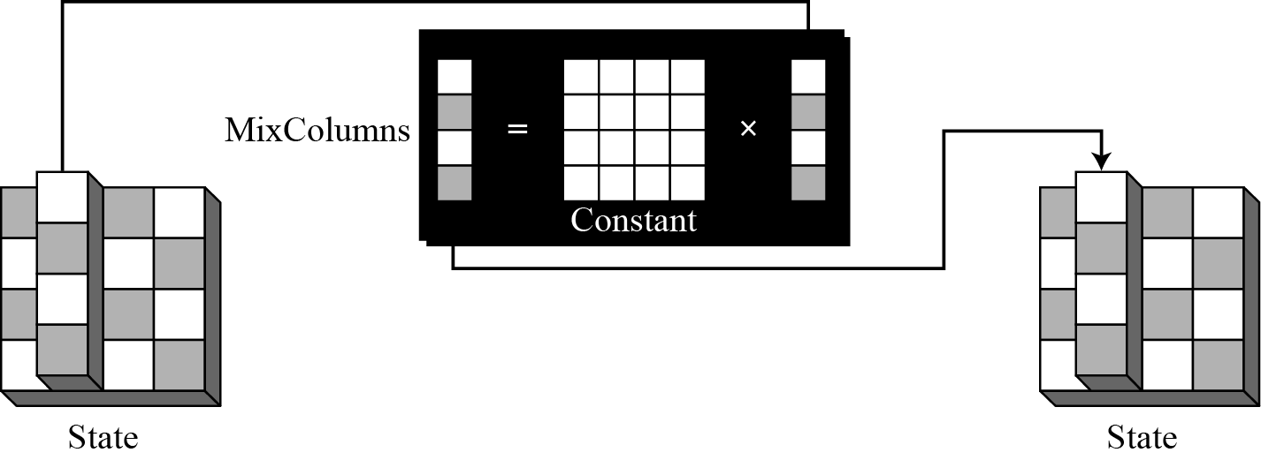
7.2.3 Continue
MixColumns
The MixColumns transformation operates at the column level; it transforms each column of the state to a new column.
Figure 7.13 MixColumns transformation
7.<number>

Slide 84
7.2.3 Continue
InvMixColumns
The InvMixColumns transformation is basically the same as the MixColumns transformation.
Note
The MixColumns and InvMixColumns transformations are inverses of each other.
7.<number>

Slide 85
7.2.4 Key Adding
AddRoundKey
AddRoundKey proceeds one column at a time. AddRoundKey adds a round key word with each state column matrix; the operation in AddRoundKey is matrix addition.
Note
The AddRoundKey transformation is the inverse of itself.
7.<number>

Slide 86
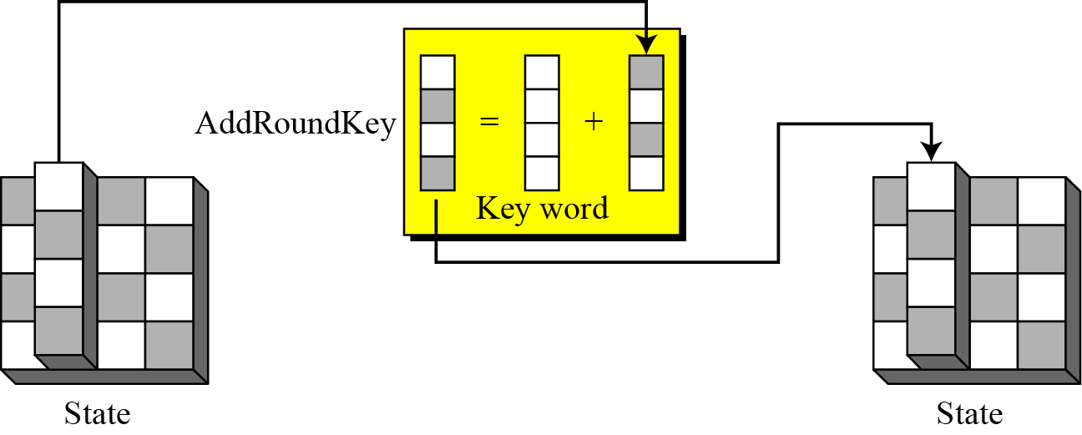
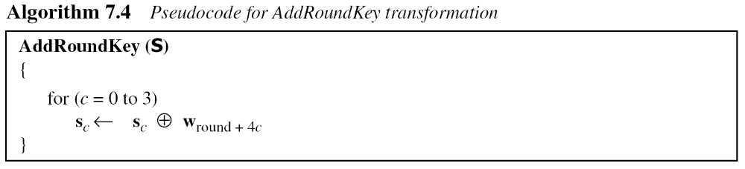
7.2.4 Continue
Figure 7.15 AddRoundKey transformation
7.<number>

Slide 87
7-3 KEY EXPANSION
To create round keys for each round, AES uses a key-expansion process. If the number of rounds is N_{r} , the key-expansion routine creates N_{r} + 1 128-bit round keys from one single 128-bit cipher key.
Topics discussed in this section:
7.3.1 Key Expansion in AES-128
7.3.2 Key Expansion in AES-192 and AES-256
7.3.3 Key-Expansion Analysis
7.<number>

Slide 88
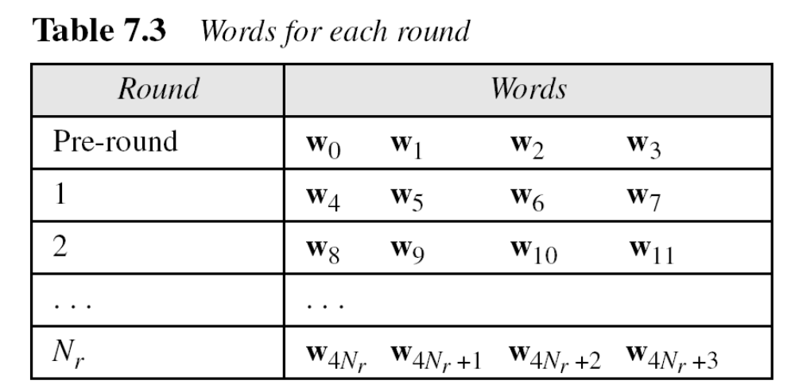
7-3 Continued
7.<number>

Slide 89
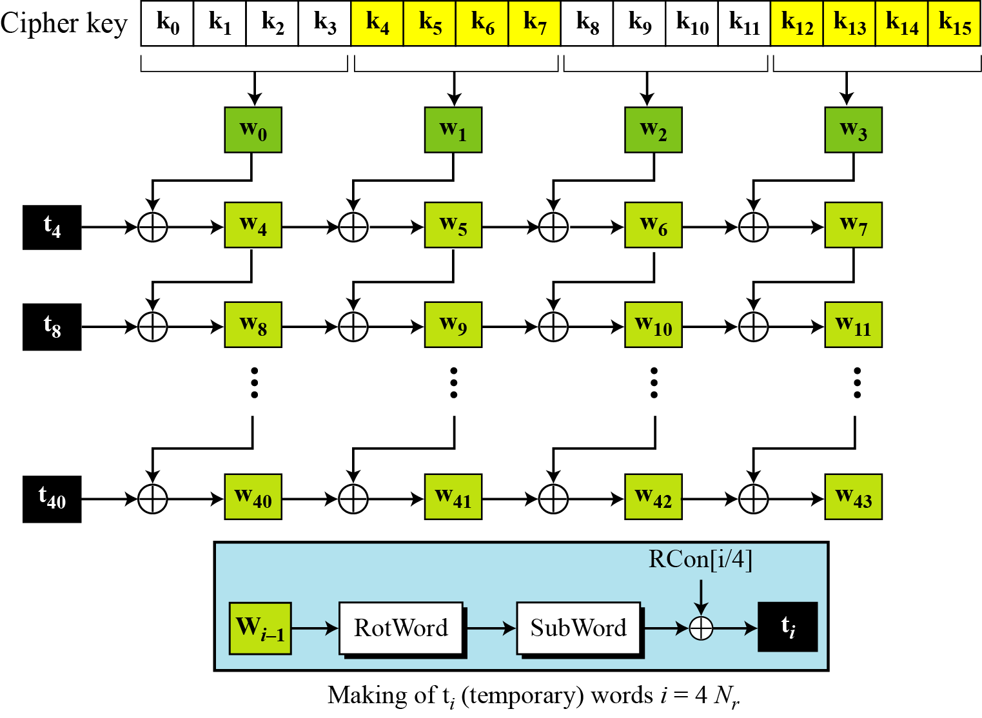
7.3.1 Key Expansion in AES-128
Figure 7.16 Key expansion in AES
7.<number>

Slide 90
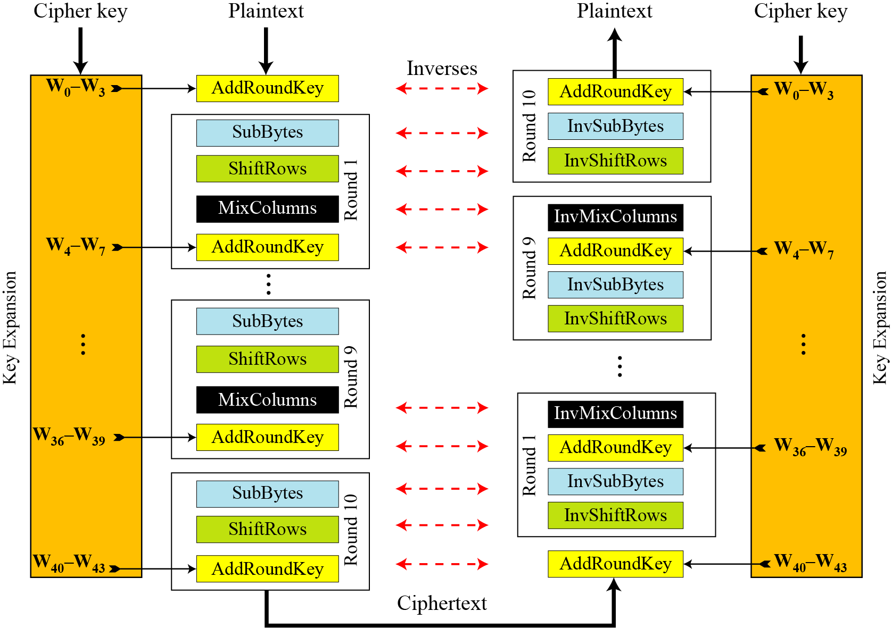
7.4.1 Original Design
Figure 7.17 Ciphers and inverse ciphers of the original design
7.<number>

Slide 91
RC4 - Stream Cipher

Slide 92


One-Time Pad
Developed by Gilbert Vernam in 1918, another name: Vernam Cipher
The key
  a truly random sequence of 0’s and 1’s
  the same length as the message
  use one time only
The encryption
  adding the key to the message modulo 2, bit by bit.
Encryption
Decryption
m_{i} : plain-text bits.
k_{i} : key (key-stream ) bits
c_{i} : cipher-text bits.

Slide 93
Example
Encryption:
1001001 1000110 plaintext
1010110 0110001 key
0011111 1110110 ciphertext
Decryption:
0011111 1110110 ciphertext
1010110 0110001 key
1001001 1000110 plaintext

Slide 94
One-Time pad practical Problem
Key-stream should be as long as plain-text
Difficult in Key distribution & Management
Solution :
  Stream Ciphers
  Key-stream is generated in pseudo-random fashion form Relatively short secret key

Slide 95
Stream Cipher Model
Output function appears random
S_{i+1}
S_{i}
S_{i} : state of the cipher
at time t = i.
F : state function.
G : output function.
F
G
Initial state, output and state
functions are controlled by the
secret key.
k_{i}
m_{i}
c_{i}

Slide 96
Random Numbers
Many uses of random numbers in cryptography
  Nonce as Initialize Vector
  Session keys
  Public key generation
  Keystream for a one-time pad
In all cases its critical that these values be
  statistically random, uniform distribution, independent
  unpredictability of future values from previous values
Care needed with generated random numbers
Notes:
Random numbers play an important role in the use of encryption for various network security applications. In this section, we provide a brief overview of the use of random numbers in cryptography and network security and then focus on the principles of pseudorandom number generation. Getting good random numbers is important, but difficult. You don't want someone guessing the key you're using to protect your communications because your "random numbers" weren't (as happened in an early release of Netscape SSL). Traditionally, the concern in the generation of a sequence of allegedly random numbers has been that the sequence of numbers be random in some well-defined statistical sense (with uniform distribution & independent). In applications such as reciprocal authentication, session key generation, and stream ciphers, the requirement is not just that the sequence of numbers be statistically random but that the successive members of the sequence are unpredictable (so that it is not possible to predict future values having observed previous values). With "true" random sequences, each number is statistically independent of other numbers in the sequence and therefore unpredictable. However, as is discussed shortly, true random numbers are seldom used; rather, sequences of numbers that appear to be random are generated by some algorithm.

Slide 97
Pseudorandom Number Generators (PRNGs)
Often use deterministic algorithmic techniques to create “random numbers”
  although are not truly random
  can pass many tests of “randomness”
Known as “Pseudorandom Numbers”
Created by “Pseudorandom Number Generators (PRNGs)”

Slide 98
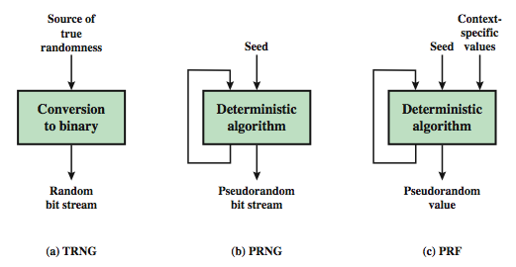
Random & Pseudorandom Number Generators
Notes:
Stallings Figure 7.1 contrasts a true random number generator (TRNG) with two forms of pseudorandom number generators. A TRNG takes as input a source that is effectively random; the source is often referred to as an entropy source. In contrast, a PRNG takes as input a fixed value, called the seed, and produces a sequence of output bits using a deterministic algorithm. Typically, as shown, there is some feedback path by which some of the results of the algorithm are fed back as input as additional output bits are produced. The important thing to note is that the output bit stream is determined solely by the input value or values, so that an adversary who knows the algorithm and the seed can reproduce the entire bit stream.
Figure 7.1 shows two different forms of PRNGs, based on application;
• Pseudorandom number generator: An algorithm that is used to produce an open-ended sequence of bits is referred to as a PRNG. A common application for an open-ended sequence of bits is as input to a symmetric stream cipher, as discussed in Section 7.4. Also, see Figure 3.1a.
• Pseudorandom function (PRF): A PRF is used to produced a pseudorandom string of bits of some fixed length. Examples are the symmetric encryption keys and nonces. Typically, the PRF takes as input a seed plus some context specific values, such as a user ID or an application ID.

Slide 99
PRNG Requirements
Randomness
  uniformity, scalability, consistency
Unpredictability
  forward & backward Unpredictability
  use same tests to check
Characteristics of the seed
  Secure
  if known adversary can determine output
  so must be random or pseudorandom number

Slide 100
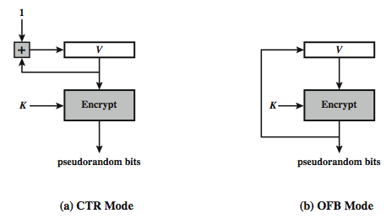
Using Block Ciphers as PRNGs
For cryptographic applications, can use a block cipher to generate random numbers
Often for creating session keys from master key
CTR
  X_{i} = E_{K}[V_{i}]
OFB
  X_{i} = E_{K}[X_{i}-1]
Notes:
A popular approach to PRNG construction is to use a symmetric block cipher as the heart of the PRNG mechanism. For any block of plaintext, a symmetric block cipher produces an output block that is apparently random. That is, there are no patterns or regularities in the ciphertext that provide information that can be used to deduce the plaintext. Thus, a symmetric block cipher is a good candidate for building a pseudorandom number generator. If an established, standardized block cipher is used, such as DES or AES, then the security characteristics of the PRNG can be established. Further, many applications already make use of DES or AES, so the inclusion of the block cipher as part of the PRNG algorithm is straightforward. Two approaches that use a block cipher to build a PNRG have gained widespread acceptance: the CTR mode and the OFB mode. The CTR mode is recommended in SP 800-90, in the ANSI standard X9.82 (Random Number Generation), and RFC 4086. The OFB mode is recommended in X9.82 and RFC 4086. Stallings Figure 7.3 illustrates the two methods. In each case, the seed consists of two parts: the encryption key value and a value V that will be updated after each block of pseudorandom numbers is generated. In the CTR case, the value of V is incremented by 1 after each encryption. In the case of OFV, the value of V is updated to equal the value of the preceding PRNG block. In both cases, pseudorandom bits are produced on block at a time.

Slide 101
Stream Ciphers
Generalization of one-time pad
Stream cipher is initialized with short key
Key is “stretched” into long keystream
  have a pseudo random property
Keystream is used like a one-time pad
  XOR to encrypt or decrypt
Notes:
A typical stream cipher encrypts plaintext one byte at a time, although a stream cipher may be designed to operate on one bit at a time or on units larger than a byte at a time. In a stream cipher, a key is input to a pseudorandom bit generator that produces a stream of 8-bit numbers that are apparently random. The output of the generator, called a keystream, is combined one byte at a time with the plaintext stream using the bitwise exclusive-OR (XOR) operation. The stream cipher is similar to the one-time pad discussed in Chapter 2. The difference is that a one-time pad uses a genuine random number stream, whereas a stream cipher uses a pseudorandom number stream. But rely on the randomness of stream key completely destroys statistically properties in message. However, you must never reuse a stream key since otherwise you can recover messages (as with a book cipher).

Slide 102

Stream Cipher Structure
Randomness of stream key completely destroys statistically properties in message
Must never reuse stream key
  otherwise can recover messages
Notes:
Stallings Figure 7.5 illustrates the general structure of a stream cipher, where a key is input to a pseudorandom bit generator that produces an apparently random keystream of bits, and which are XOR’d with message to encrypt it, and XOR’d again to decrypt it by the receiver.
Encryption
Using a secret key generate the RC4 keystream using the KSA and PRGA.
Read the file and xor each byte of the file with the corresponding keystream byte.
Write this encrypted output to a file.
Transmit file over an insecure channel.
Decryption
Using the same secret key used to encrypt generate the RC4 keystream.
Read the encrypted file and Xor every byte of this encrypted stream with the corresponding byte of the keystream.
This will yield the original plaintext

Slide 103
Stream Cipher Properties
Some design considerations are:
  long period with no repetitions
  statistically random
  depends on large enough key
  large linear complexity
Properly designed, can be as secure as a block cipher with same size key
Benefit : usually simpler & faster
Notes:
[KUMA97] lists the following important design considerations for a stream cipher:
The encryption sequence should have a large period, the longer the period of repeat the more difficult it will be to do cryptanalysis.
The keystream should approximate the properties of a true random number stream as close as possible, the more random-appearing the keystream is, the more randomized the ciphertext is, making cryptanalysis more difficult.
To guard against brute-force attacks, the key needs to be sufficiently long. The same considerations as apply for block ciphers are valid here .Thus, with current technology, a key length of at least 128 bits is desirable.
With a properly designed pseudorandom number generator, a stream cipher can be as secure as block cipher of comparable key length. The primary advantage of a stream cipher is that stream ciphers are almost always faster and use far less code than do block ciphers. A stream cipher can be constructed with any cryptographically strong PRNG.

Slide 104
RC4 Basics
A symmetric key encryption algorithm invented by Ron Rivest
  A proprietary cipher owned by RSA, kept secret
  Code released anonymously in Cyberpunks mailing list in 1994
  Later posted sci.crypt newsgroup
Variable key size, byte-oriented stream cipher
  Normally uses 64 bit and 128 bit key sizes.
Used in
  SSL/TLS (Secure socket, transport layer security) between web browsers and servers,
  IEEE 802.11 wirelss LAN std: WEP (Wired Equivalent Privacy), WPA (WiFi Protocol Access) protocol
Notes:
RC4 is a stream cipher designed in 1987 by Ron Rivest for RSA Security. It is a variable key-size stream cipher with byte-oriented operations. The algorithm is based on the use of a random permutation. Analysis shows that the period of the cipher is overwhelmingly likely to be greater than 10^100. Eight to sixteen machine operations are required per output byte, and the cipher can be expected to run very quickly in software. RC4 is probably the most widely used stream cipher. It is used in the SSL/TLS secure web protocol, & in the WEP & WPA wireless LAN security protocols. RC4 was kept as a trade secret by RSA Security, but in September 1994 was anonymously posted on the Internet on the Cypherpunks anonymous remailers list. In brief, the RC4 key is ued to form a random permutation of all 8-bit values, it then uses that permutation to scramble input info processed a byte at a time.

Slide 105
RC4-based Usage
WEP
WPA default
Bit Torrent Protocol Encryption
Microsoft Point-to-Point Encryption
SSL (optionally)
SSH (optionally)
Remote Desktop Protocol
Kerberos (optionally)

Slide 106

RC4 Block Diagram
Secret Key
RC4
Keystream
Plain Text
+
Encrypted
Text
Cryptographically very strong and easy to implement

Slide 107
RC4 …Inside
Consists of 2 parts:
  Key Scheduling Algorithm (KSA)
  Pseudo-Random Generation Algorithm (PRGA)
KSA
  Generate State array
PRGA on the KSA
  Generate keystream
  XOR keystream with the data to generated encrypted stream
KSA
PRGA

Slide 108
The KSA
Use the secret key to initialize and permutation of state vector S, done in two steps
Use 8-bit index pointers i and j
1
2
  for i = 0 to 255 do
    S[i] = i;
    T[i] = K[i mod(|K|)]);
  j = 0;
  for i = 0 to 255 do
    j = (j+S[i]+T[i])(mod 256)
    swap (S[i], S[j])
[S], S is set equal to the values from 0 to 255
  S[0]=0, S[1]=1,…, S[255]=255
[T], A temporary vector
[K], Array of bytes of secret key
|K| = Keylen, Length of (K)
Use T to produce initial permutation of S
The only operation on S is a swap;
S still contains number from 0 to 255
After KSA, the input key and the temporary vector T will be no longer used

Slide 109
The PRGA
Generate key stream k , one by one
XOR S[k] with next byte of message to encrypt/decrypt
  i = j = 0;
  While (more_byte_to_encrypt)
    i = (i + 1) (mod 256);
    j = (j + S[i]) (mod 256);
    swap(S[i], S[j]);
    k = (S[i] + S[j]) (mod 256);
    C_{i} = M_{i} XOR S[k];
Sum of shuffled pair selects "stream key" value from permutation

Slide 110
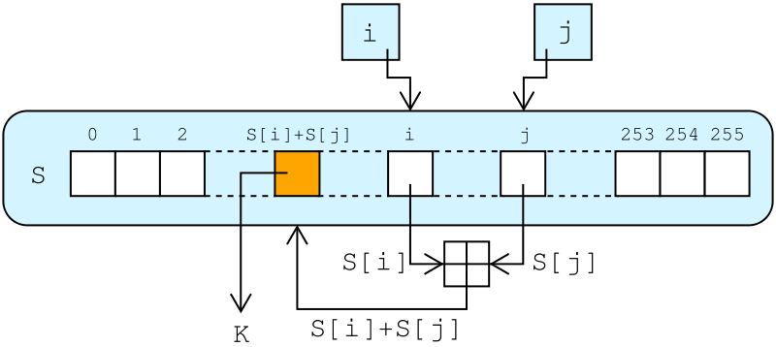
RC4 Lookup Stage
The output byte is selected by looking up the values of S[i] and S[j], adding them together modulo 256, and then looking up the sum in S
S [S[i] + S[j]] is used as a byte of the key stream, K
  i = j = 0;
  While (more_byte_to_encrypt)
    i = (i + 1) (mod 256);
    j = (j + S[i]) (mod 256);
    swap(S[i], S[j]);
    k = (S[i] + S[j]) (mod 256);
    C_{i} = M_{i} XOR S[k];
http://en.wikipedia.org/wiki/File:RC4.svg

Slide 111
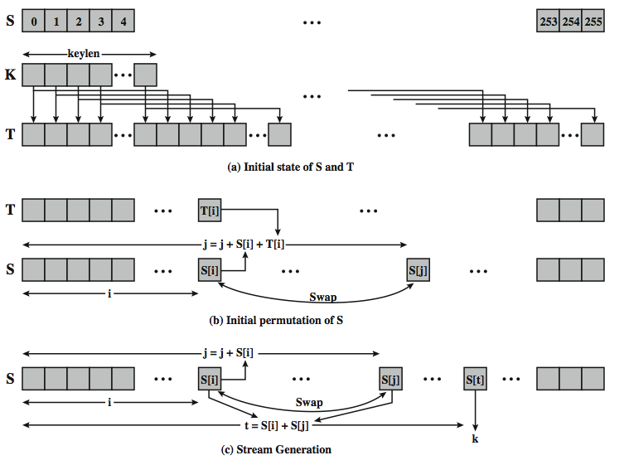
Detailed Diagram

Slide 112
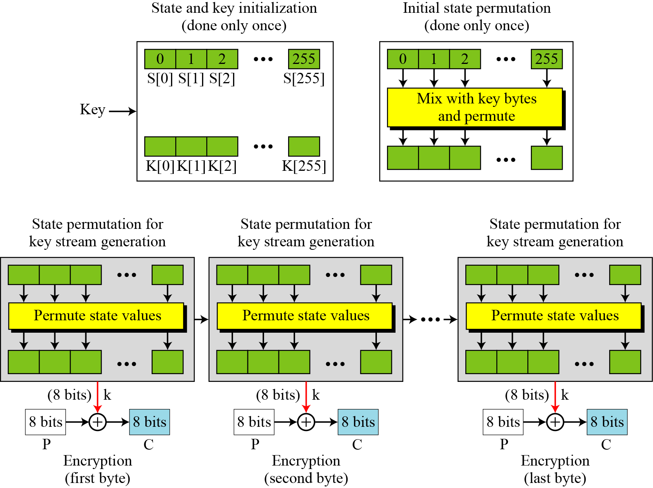
Overall Operation of RC4

Slide 113
Decryption using RC4
Use the same secret key as during the encryption phase.
Generate keystream by running the KSA and PRGA.
XOR keystream with the encrypted text to generate the plain text.
Logic is simple :
(A xor B) xor B = A
A = Plain Text or Data
B = KeyStream

Slide 114
RC4 and WEP
WEP is a protocol using RC4 to encrypt packets for transmission over IEEE 802.11 wireless LAN.
WEP requires each packet to be encrypted with a separate RC4 key.
The RC4 key for each packet is a concatenation of a 24-bit IV (initialization vector) and a 40 or 104-bit long-term key.
RC4 key: IV (24) Long-term key (40 or 104 bits)
l

Slide 115
RC5
can vary key size / input data size / #rounds
very clean and simple design
easy implementation on various CPUs
yet still regarded as secure
  Vary parameters to achieve tradeoffs

Slide 116
RC5 Ciphers
RC5 is a family of ciphers RC5-w/r/b
  w = word size in bits (16/32/64) data=2w
  r = number of rounds (0..255)
  b = number of bytes in key (0..255)
nominal version is RC5-32/12/16
  ie 32-bit words so encrypts 64-bit data blocks
  using 12 rounds
  with 16 bytes (128-bit) secret key

Slide 117
RC5 Key Expansion
RC5 uses 2r+2 subkey words (w-bits)
  Two subkeys for each round
  2 subkeys for additional operations
subkeys are stored in array S[i], i=0..t-1
Key expansion: fill in pseudo-random bits to the original key K
Certain amount of one-wayness
  Difficult to determine K from S

Slide 118
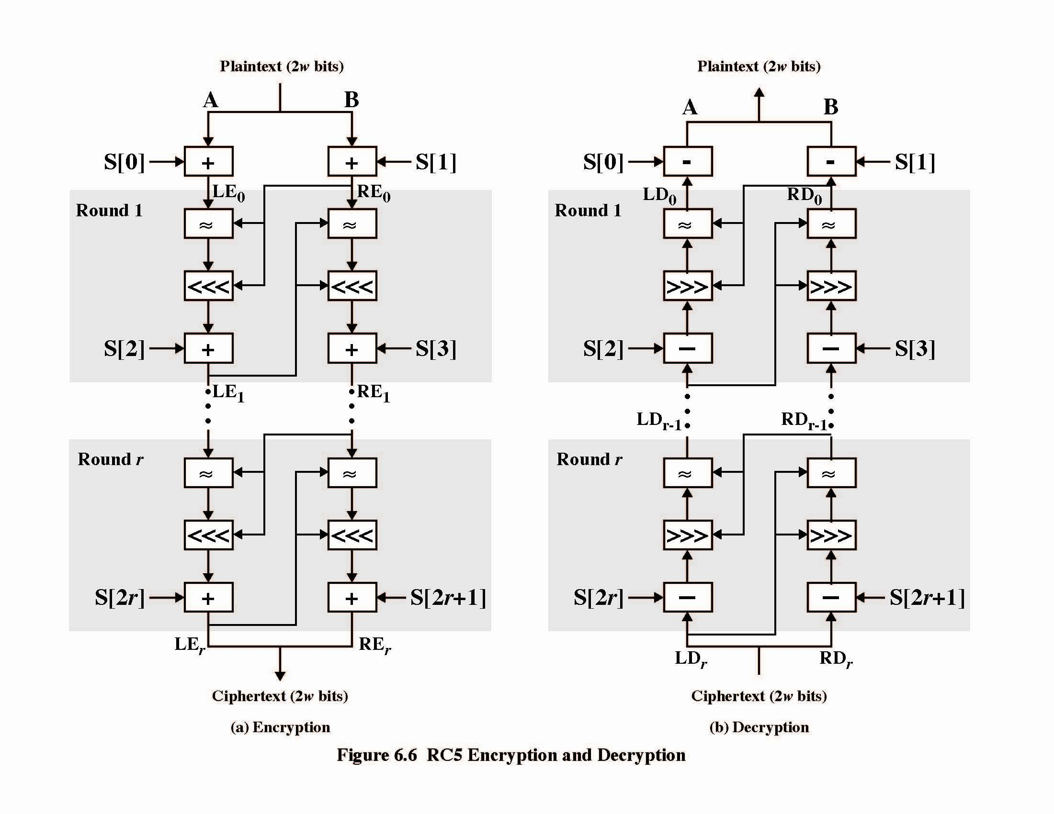

Slide 119
RC5 Encryption
split input into two halves A & B
  L₀ = A + S[0];
  R₀ = B + S[1];
  for i = 1 to r do
    L_{i} = ((L_{i-1} XOR R_{i-1}) <<< R_{i-1}) + S[2 x i];
    R_{i} = ((R_{i-1} XOR L_{i}) <<< L_{i}) + S[2 x i + 1];
each round is like 2 DES rounds
note rotation is main source of non-linearity
need reasonable number of rounds (eg 12-16)
Striking features: simplicity, data-dependent rotations

Slide 120
RC5 Modes
RFC2040 defines 4 modes used by RC5
  RC5 Block Cipher, is ECB mode
  RC5-CBC, input length is a multiples of 2w
  RC5-CBC-PAD, any length CBC with padding
    Output can be longer than input
  RC5-CTS, CBC with padding
    Output has same length than input

Slide 121
Blowfish
a symmetric block cipher designed by Bruce Schneier in 1993/94
characteristics
  fast implementation on 32-bit CPUs, 18 clock cycles per byte
  compact in use of memory, less than 5KB
  simple structure for analysis/implementation
  variable security by varying key size
    Allows tuning for speed/security tradeoff

Slide 122
Blowfish Key Schedule
uses a 32 to 448 bit key
used to generate
  18 32-bit subkeys stored in P-array: P1 to P18
  S-boxes stored in S_{i,j,}
    i=1..4
    j=0..255

Slide 123
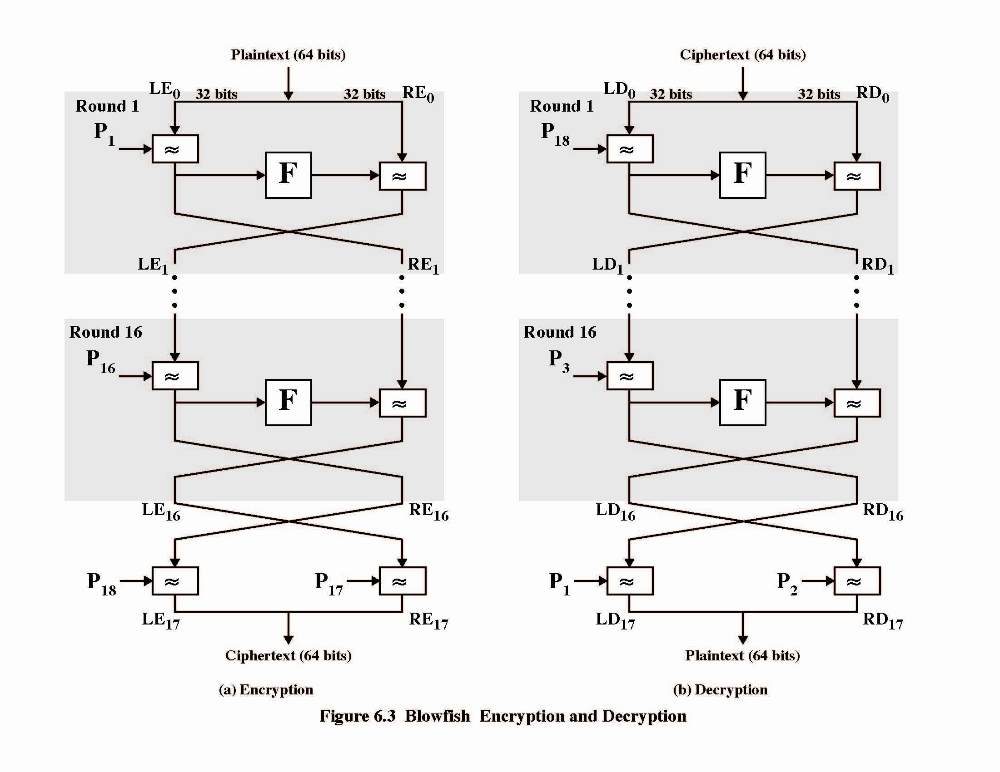

Slide 124
Blowfish Encryption
uses two primitives: addition & XOR
data is divided into two 32-bit halves L₀ & R₀
  for i = 1 to 16 do
    R_{i} = L_{i-1} XOR P_{i};
    L_{i} = F[R_{i}] XOR R_{i-1};
  L₁₇ = R₁₆ XOR P₁₈;
  R₁₇ = L₁₆ XOR i₁₇;
where
  F[a,b,c,d] = ((S_{1,a} + S_{2,b}) XOR S_{3,c}) + S_{4,a}
  Break 32-bit R_{i} into (a,b,c,d)

Slide 125
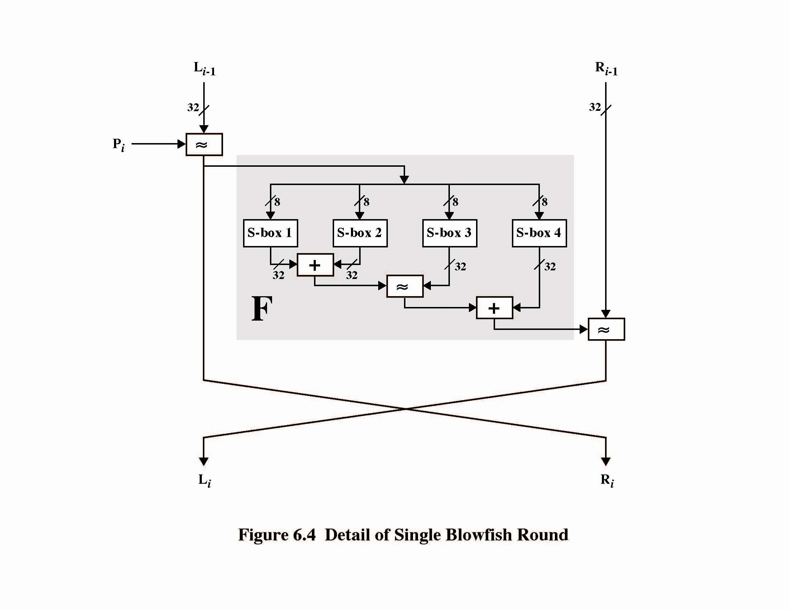

Slide 126
Discussion
provided key is large enough, brute-force key search is not practical, especially given the high key schedule cost
key dependent S-boxes and subkeys make analysis very difficult
  Very few cryptoanalysis results on blowfish
changing both halves in each round increases security
  Some study shows improved avalanche effects

Slide 127

IDEA & BLOWFISH
6.<number>

